Slide 1
Training games with other games
Rover Vos Non-Entertainment Games
19/06/2023

Slide 2
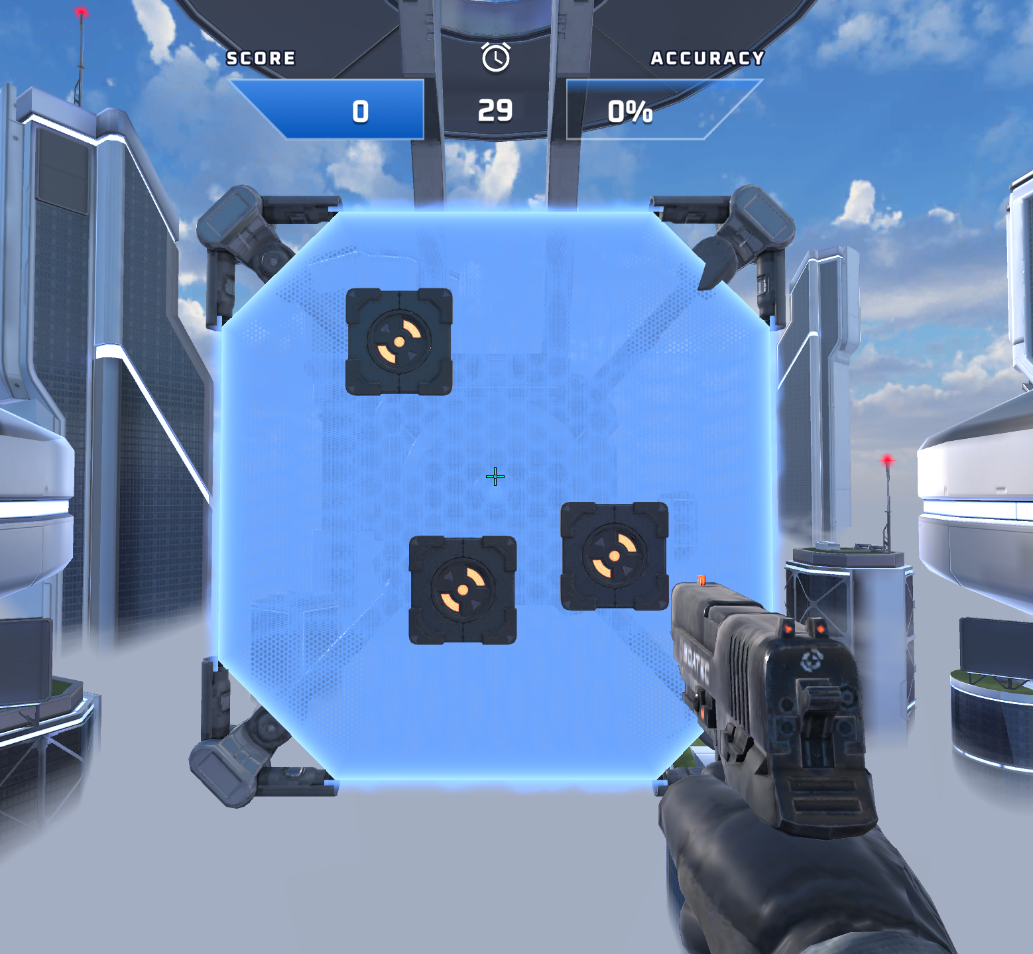
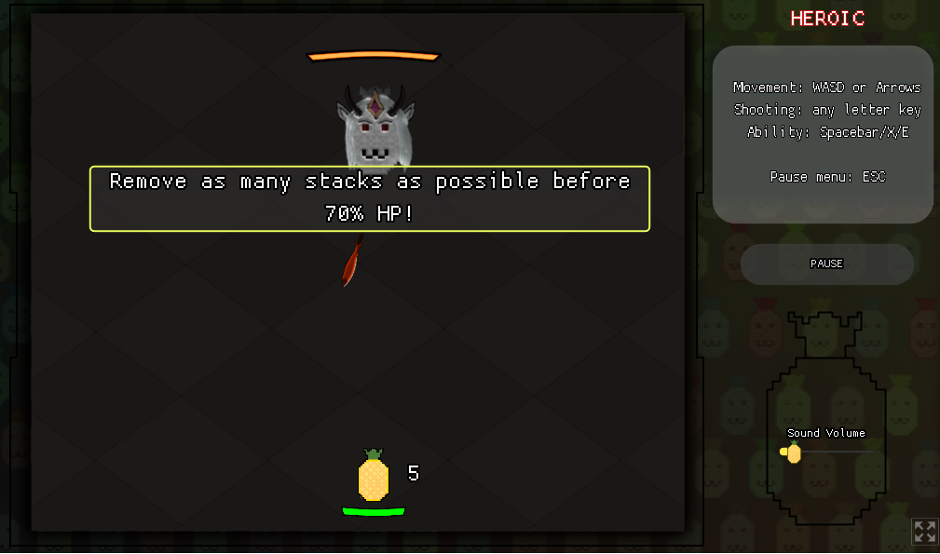
What?
3D Aim Trainer
Castle Pineapplia

Slide 3
Why this topic?

Slide 4
What did I find?

Slide 5
Quantitative data

Slide 6
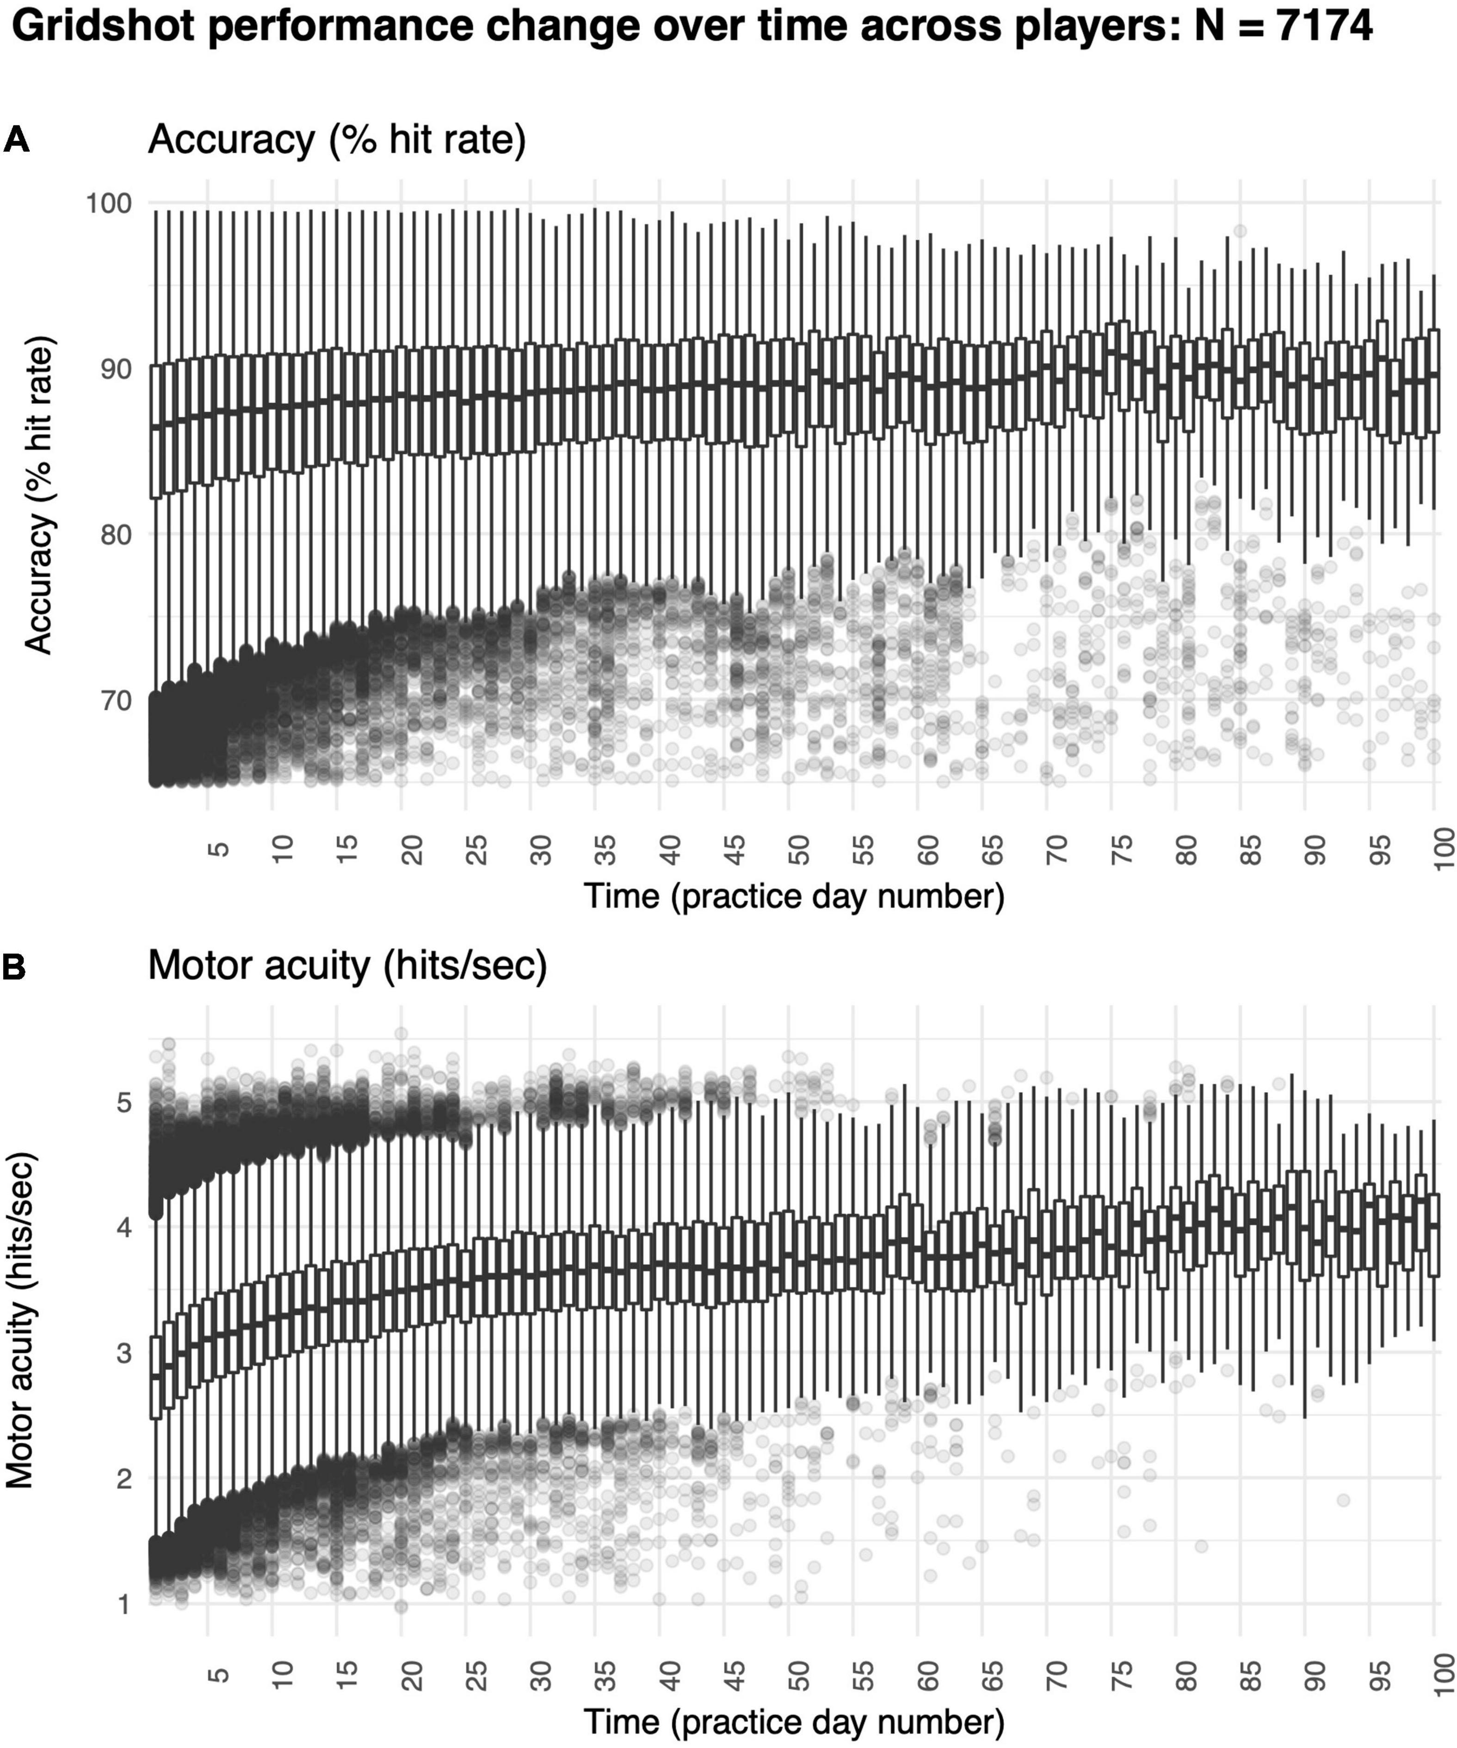

Slide 7
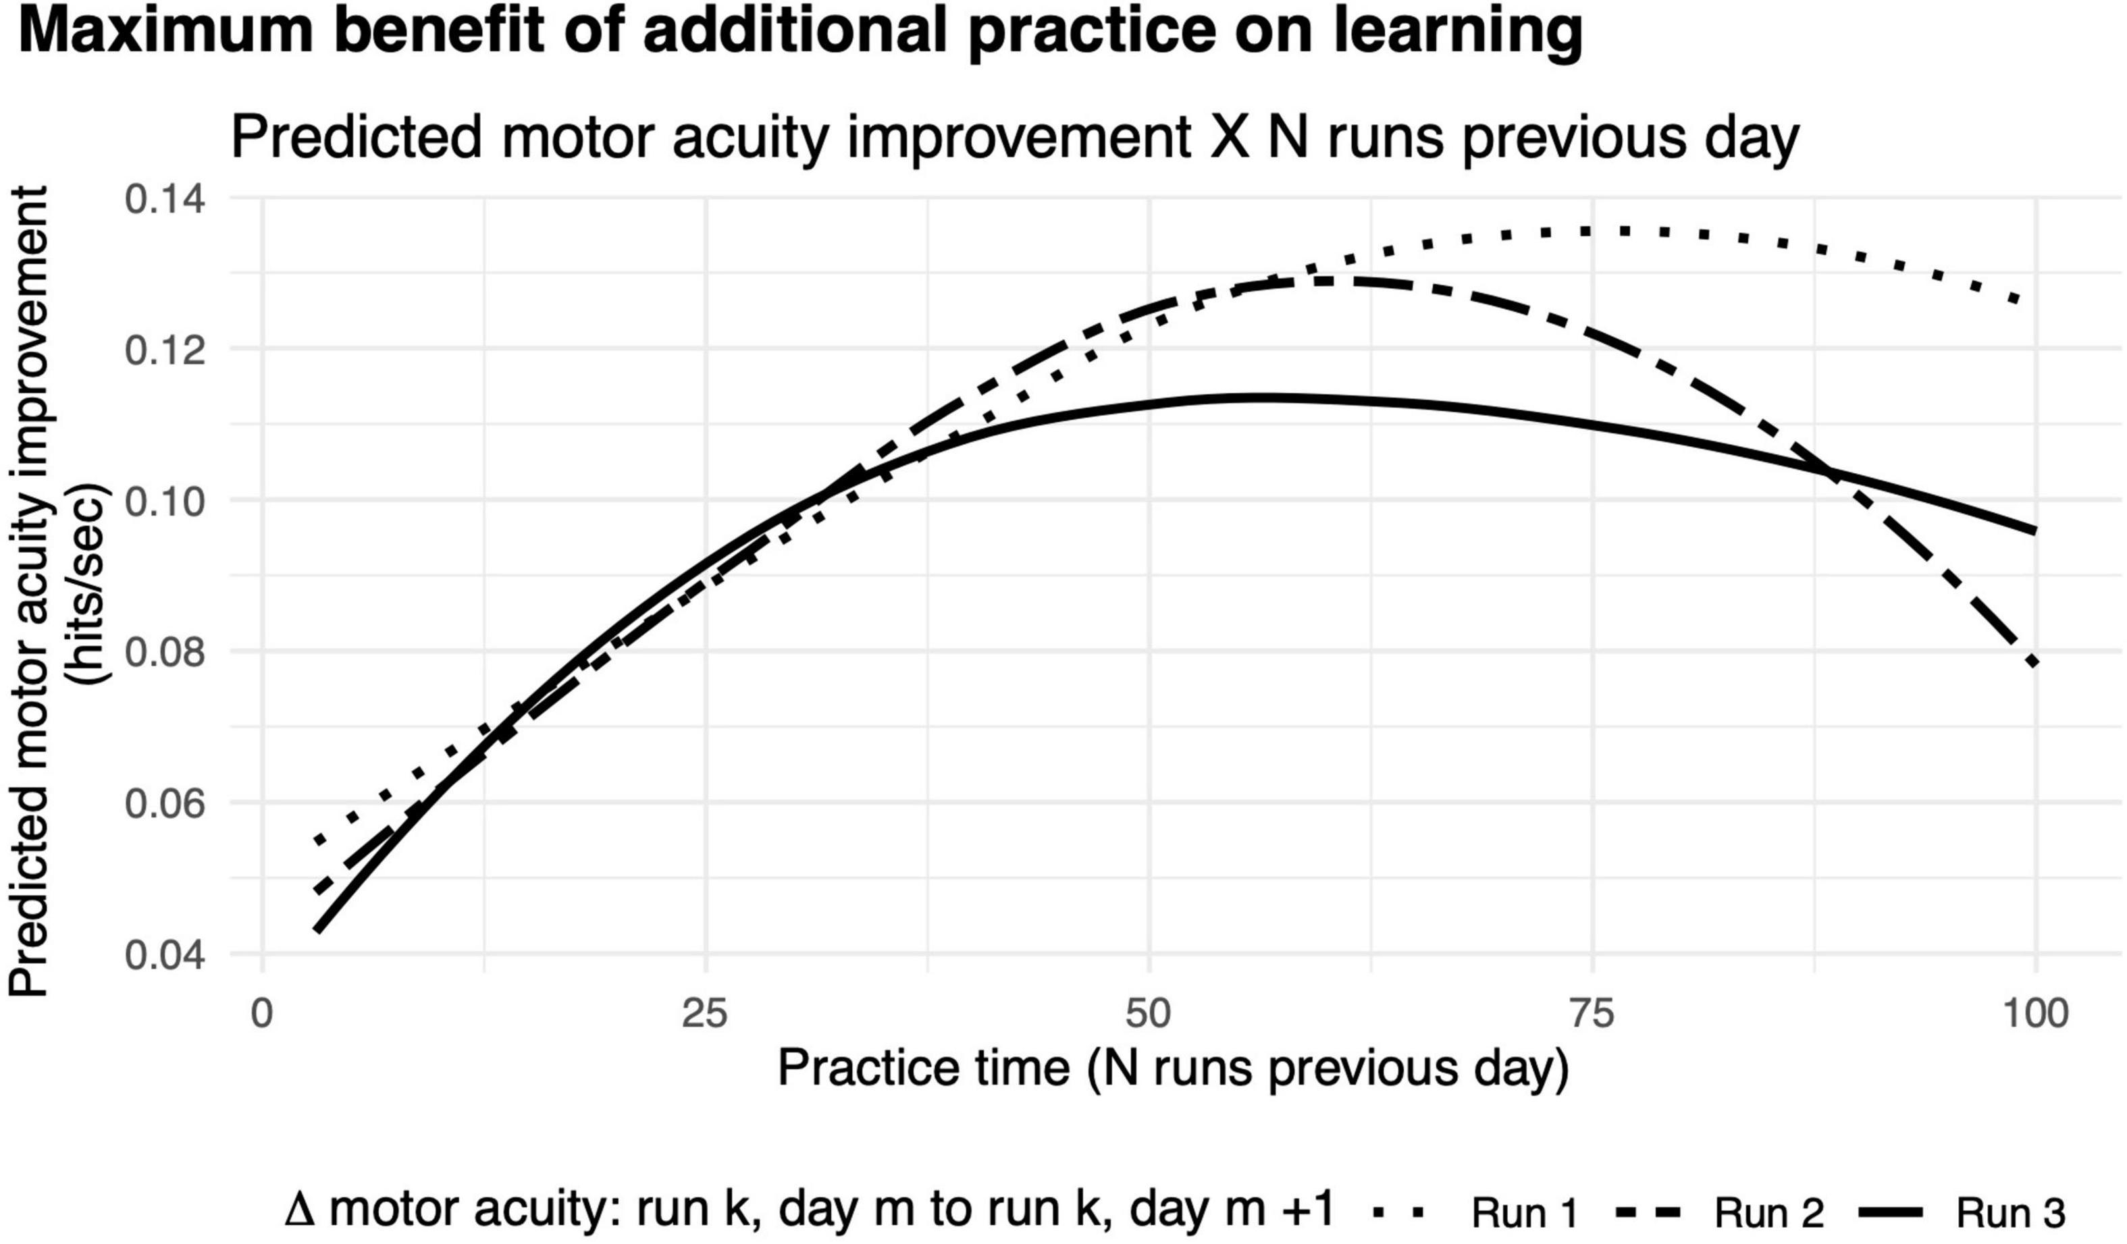

Slide 8
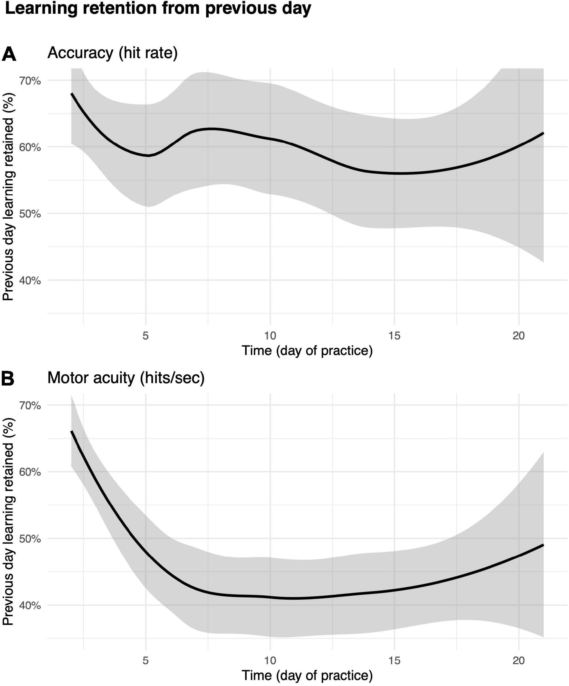

Slide 9
What I couldn’t find

Slide 10
Little bit of my own bad field research
Competition VS Community

Slide 11
Training games with other games
Rover Vos Non-Entertainment Games
19/06/2023

Slide 12
Bibliography
3D Aim Trainer. 2021. 3D Aim Trainer. Dendermonde, Belgium: 3D Aim Trainer
Listman ,Jennifer B., Jonathan S. Tsay, Hyosub E. Kim, Wayne E. Mackey and David J. Heeger. 2021. "Long-Term Motor Learning in the “Wild” With High Volume Video Game Data " Frontiers in Human Neuroscience. Volume 15.
Roldan, Cheselle Jan and Yogi Tri Prasetyo. 2021. "Evaluating The Effects of Aim Lab Training on Filipino Valorant Players' Shooting Accuracy" IEEE 8th International Conference on Industrial Engineering and Applications (ICIEA). 465-470.
Statespace. 2020. Next Gen FPS Training Has Arrived. Statespace. https://aimlab.gg3
TacticalAirHorse. 2022. Castle Pineapplia. Itch.io: TacticalAirHorse

